Slide 1
Real Options Analysis and Strategic Decision Making
Edward H. Bowman and Gary T. Moskowitz (2001)
Organization Science
Daniela Pedraza Novak, Spring 2021

Slide 2
Introduction
Investment decisions are critical processes by which an organization commits resources to future growth.
Real options offer a positive and radical reassessment of the value of risk and exploration, yet organizational theories and financial theories are rarely considered in tandem.
How to analyze capital allocation proposals?
Traditional corporate finance theory suggests that firms should use a discounted cash flow model (DCF) to calculate the net present value (NPV).
If a proposal has a positive present value, then the project should be funded.
Typically, this approach does not properly account for the flexibility that may be present in a project.
Real options theory has been suggested as a capital budgeting and strategic decision-making tool.
It accounts for the value of future flexibility.
Assumes an underpinning source of uncertainty, which over time is revealed.

Slide 3
Overview
Motivation:
Despite the theoretical attractiveness of the real options approach, its use by managers appears to be limited.
Goal:
To examine some of the practical organizational issues associated with the use of real options analysis.
Illustrate these problems using Merck’s real options calculation.
Contribution:
Show how the results of strategic analysis can differ from the assumptions of a typical options model.

Slide 4
Strategic Real Options
Strategy researchers have suggested that several corporate decisions can be best viewed through a strategic options lens.
Termination of JVs, management of multinational manufacturing networks, VC investments, R&D programs, and some capital budgeting decisions.
These decisions entail a two-stage process:
Small initial investment gives the right to participate in a project (purchase the option).
Some time later - when more information is known the firm faces the choice to make a larger investment in the project (exercise the option).
A real option must be analyzed multiple times by the firm:
Whether or not to purchase the option → Value of option > Cost of the option
Whether or not and when to exercise the option → Value of project ≠ Exercise price of option

Slide 5
Merck’s Analysis
Project Gamma:
Merck wants to enter a new line of business but needs the new technology from Gamma.
Biotech company Gamma has patented its technology but has not developed any commercial applications from it.
If Merck licenses the technology, it will take two years of research and development before any product is ready.
If after two years the new product is commercially feasible, it will take another year to complete the start-up requirements (build plant, marketing, working capital etc.)
Proposed Agreement: Merck used a real options calculation to justify the investment
Merck pays Gamma a $2M license fee over a 3-year period + royalties.
Merck can terminate the agreement anytime if dissatisfied with the progress of the research.
The agreement resembles a call option
Value of option ≈ ∑(license fee + R&D cost)

Slide 6
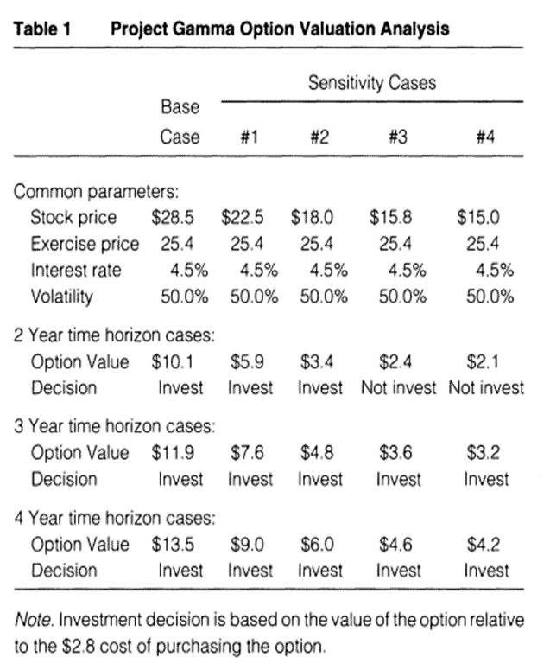
Merck’s Analysis
Black & Scholes Model
Stock price (S) – Expected present value of the cash flows from the project (NPV technique).
Exercise price (K) – Cost of building the plant + associated start-up costs of commercialization.
Time to expiration (t) – Expected time to develop the product and build the plant.
Volatility (N) – Based on the annual standard deviation of returns for biotechnology stocks = (0.5)
Risk free interest rate (r) – Based on the then prevailing yield on two-to-four-year Treasury bonds = (4.5%)

Slide 7
Limitations of the Quantitative Approach
Find a model whose assumptions match those of the project being analyzed.
Black & Scholes embedded assumptions about the distribution of future stock prices → The longer Merck waits the more valuable the option becomes.
Strategic analysis → patent has a fixed expiration date, so the longer Merck waits the lower the overall economic value.
Determine the inputs to the selected model.
Stock price – projects do not have a readily observable stock price / errors in NPV will become errors in the option valuation.
Exercise price – Many strategic investments do not have a fixed exercise price.
Time to expiration – For strategic real options there is often no set time to expiration.
Volatility – For many strategic investments there may not be publicly traded instruments whose risk profile matches that of the proposed investment.
Mathematically solve the option pricing algorithm.

Slide 8
Option Analysis in Strategic Planning
Real options present planners with a dilemma:
Theoretically, options are a good way to think about the flexibility inherent in many investment proposals.
Practically, the methodology presents many difficulties which may lead to erroneous conclusions.
How to solve the dilemma?
Create more advanced and customized valuation models that better match the characteristics of the investment proposals at hand.
The Merck case showed:
Firms need to perform both financial and strategic analyses.
An option approach encourages experimentation and the proactive exploration of uncertainty.

Slide 9
Discussion
By analyzing the case of Merck, this SMJ article shows us the potential practical difficulties of using real options to value investments.
Yet, there are opportunities to customize finance models and use them in strategic planning
A dynamic view will be needed when customizing and using the finance model.
Limitations of the Black and Scholes model that were not discussed:
Assumes no early exercise – Fits only European options, not American type options.
Assumes continuous and costless trading - There are not transaction costs in buying the option.

